Slide 1
Bell Work:
Given:
f(x) = 4x – 12
g(x) = ½ x + 8
Simplify the following:
1.) g(6)
2.) g(f(x))
3.) g(f(-3))

Slide 2
Pre-calc trig
Day 8

Slide 3
Objective
Get comfortable doing math within story problems
Continue to work with linear functions and their formulas
Manipulate functions and discuss their domain and range

Slide 4
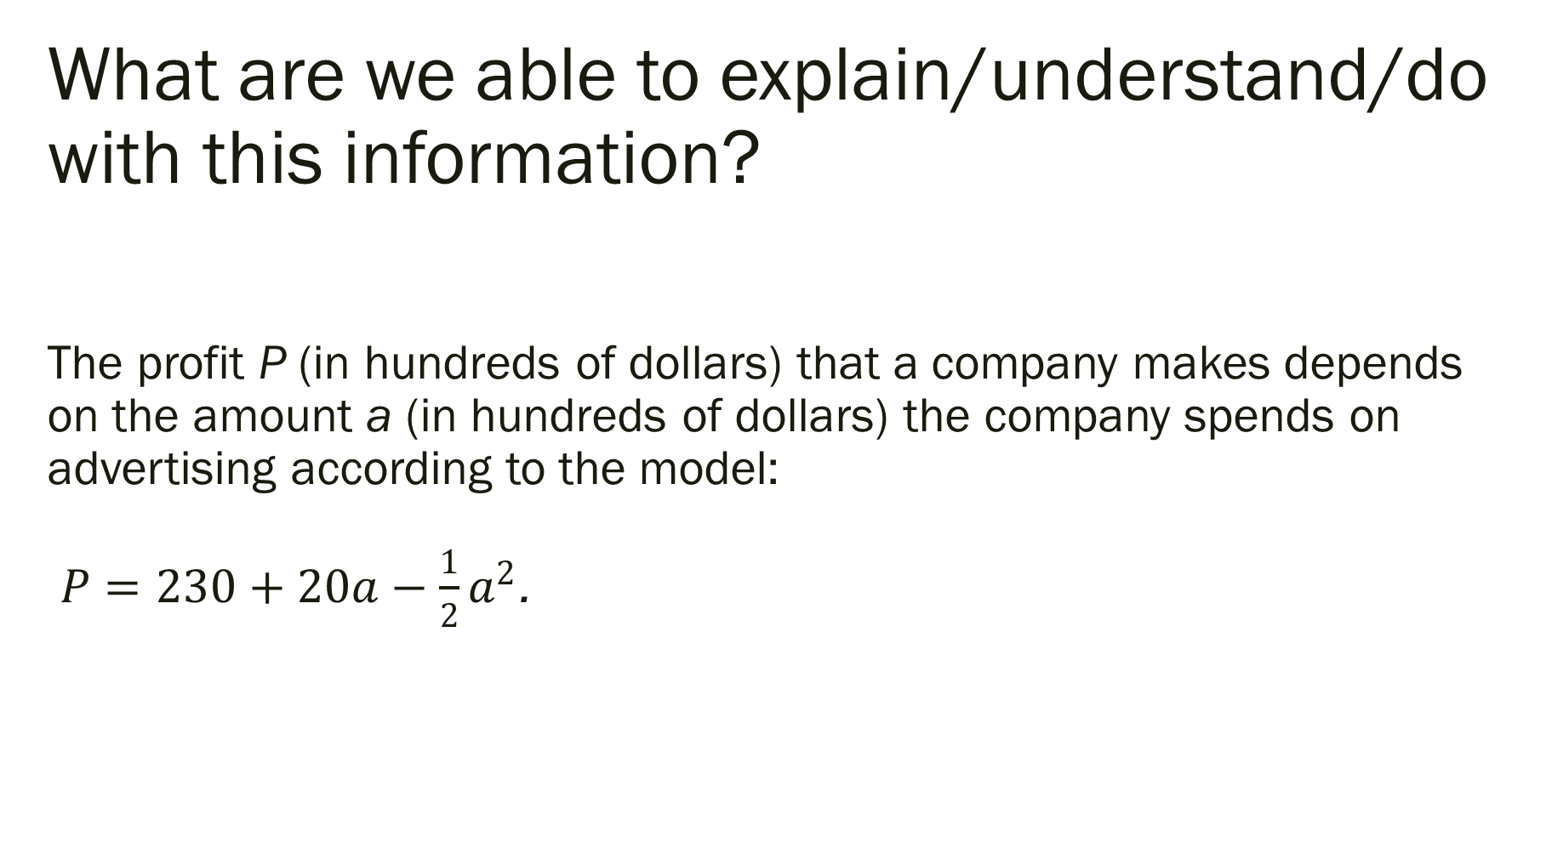
What are we able to explain/understand/do with this information? The profit P (in hundreds of dollars) that a company makes depends on the amount a (in hundreds of dollars) the company spends on advertising according to the model: $P=230+20a−\frac{1}{2}a^{2}$.

Slide 5
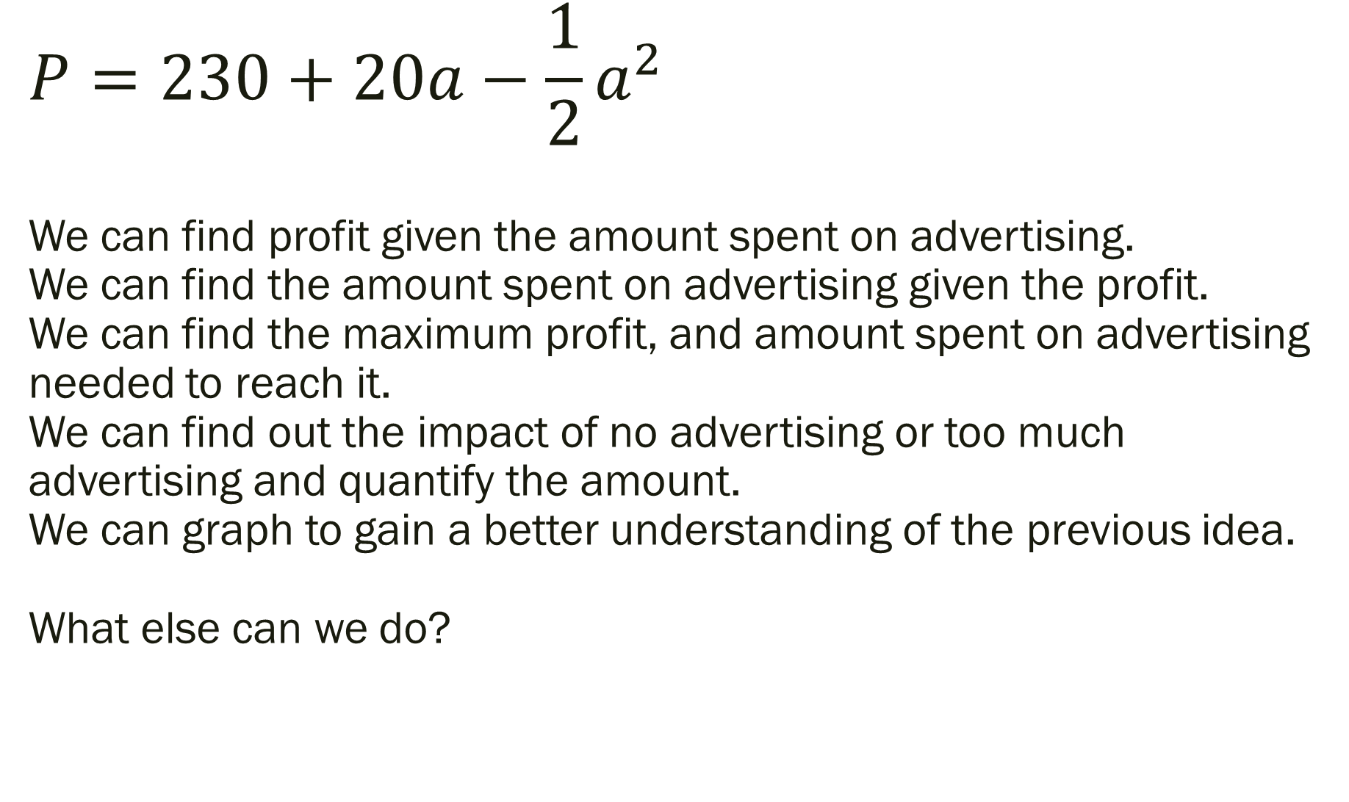
$$P=230+20a−\frac{1}{2}a^{2}$$ We can find profit given the amount spent on advertising. We can find the amount spent on advertising given the profit. We can find the maximum profit, and amount spent on advertising needed to reach it. We can find out the impact of no advertising or too much advertising and quantify the amount. We can graph to gain a better understanding of the previous idea. What else can we do?

Slide 6
If you are given two points, and told they form a line… what can you do with them? Here are two points… GO! (6,1) and (-2,5)

Slide 7
Two points: (6,1) and (-2,5) -How far apart are these two points? -What point is in the middle of them? -Where are they located on a graph? -What does the line connecting them look like? -What is the slope between these two points? -What is the equation in slope intercept form? -Did you find the equation with point-slope form? -Did you find the equation another way? -What other points are on this line? -How would an inequality instead of an equal sign change the way the graph looks? -Can you describe the domain and range of the points? How about the line they are on? What else did you come up with?

Slide 8
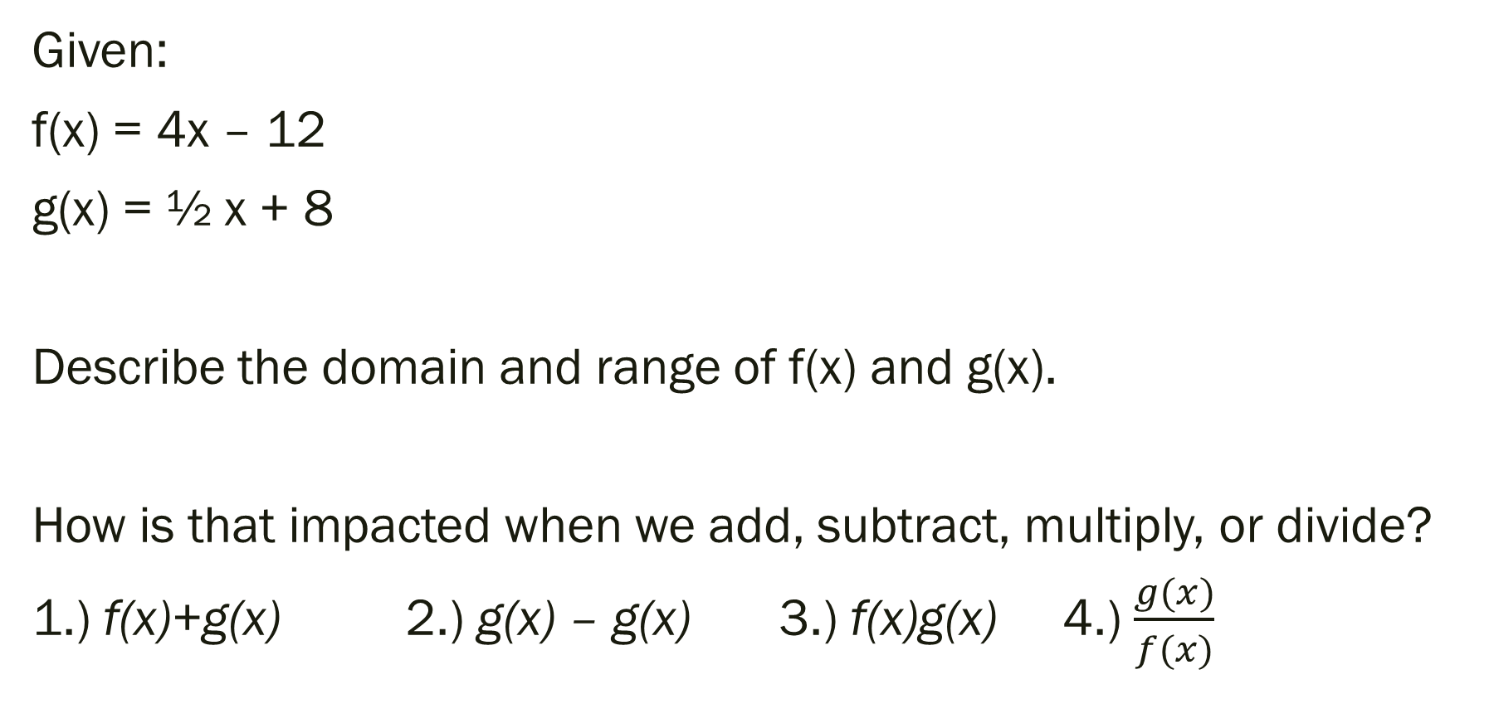
Functions and Their Graphs [Back to Bell Work]
Given:
f(x) = 4x – 12
g(x) = ½ x + 8
Describe the domain and range of f(x) and g(x).
How is that impacted when we add, subtract, multiply, or divide?
1.) f(x)+g(x) 2.) g(x) – g(x) 3.) f(x)g(x) 4.) $\frac{g(x)}{f(x)}$

Slide 9

What do you notice about the graphs?
Given:
f(x) = 4x – 12
g(x) = ½ x + 8
How is the domain and range impacted?
1.) f(x)+g(x) 2.) g(x) – g(x) 3.) f(x)g(x) 4.) $\frac{g(x)}{f(x)}$

Slide 10
What about composite functions?
Given:
f(x) = 4x – 12
g(x) = ½ x + 8
Simplify and describe the domain and range:
1.) g(g(x))
2.) f(g(m))

Slide 11
For Next Time…
Page 23 #86
Page 33 #33, 57, 65, 120
Page 49 #37, 51, 75, 79, 97
Page 61 #9-11

